Slide 1
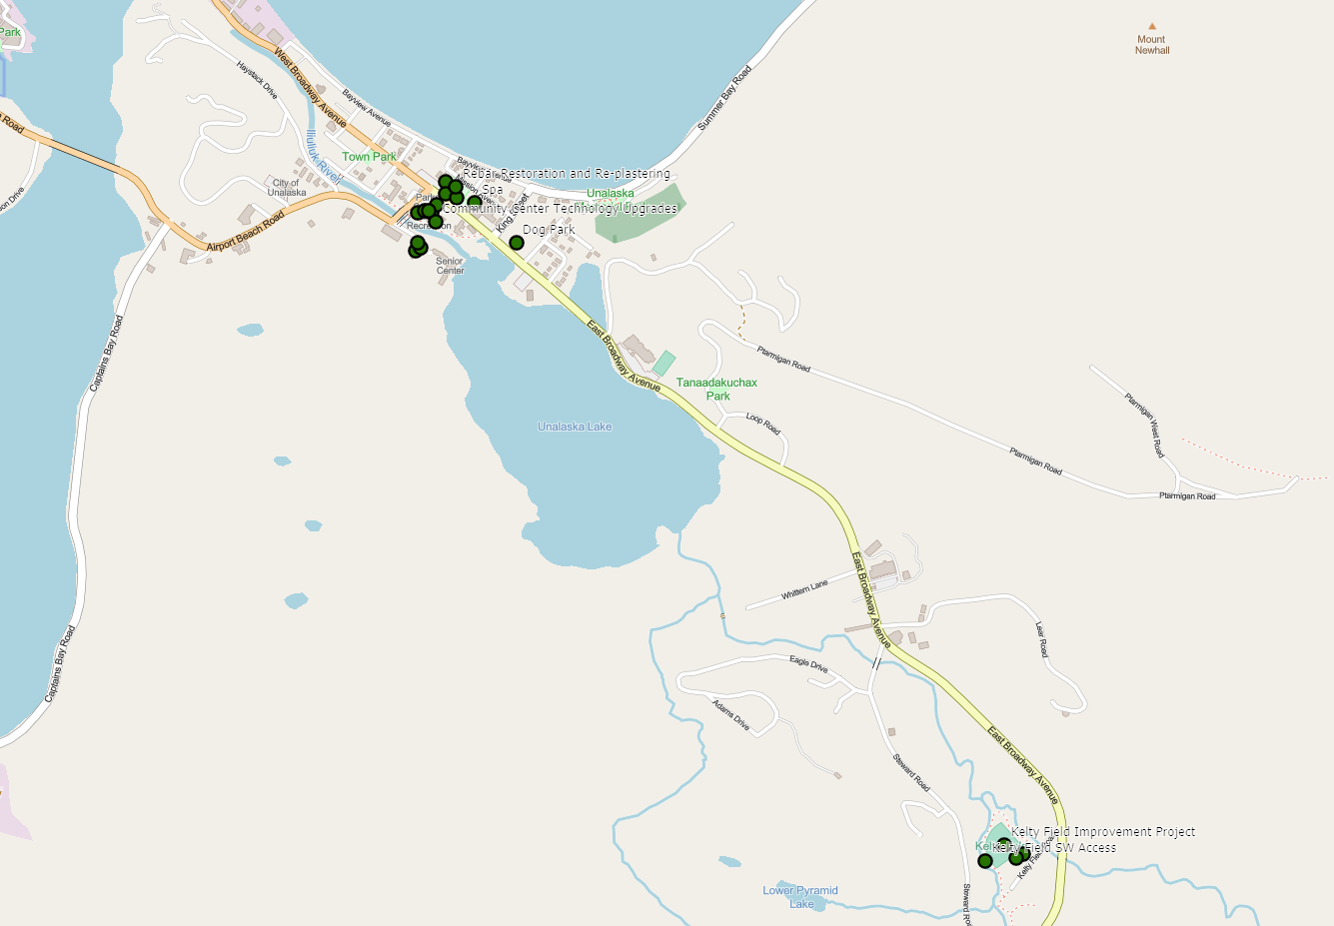
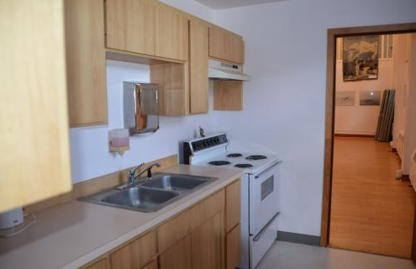
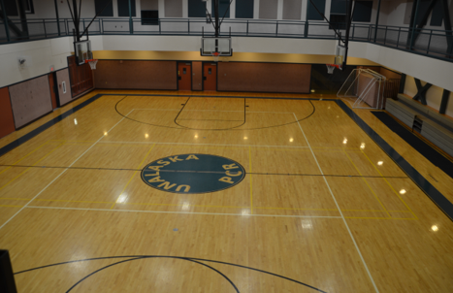
PCR CMMP plan

Slide 2
FY 23 – FY 30
FY 23
Comprehensive Plan
FY 24
Community Center Playground
FY 25
Burma Road Kitchen
Pool Mezzanine and Office Space Expansion
FY 26
Gymnasium Floor Replacement
Pump Track
FY 27
Technology Upgrades for the Community Center
Rebar Restoration and Re-plastering the Pool
Dog Park at Tutiakoff
FY 28
Multipurpose Facility
FY 29
Replace the playground at Kelty Field
Bridge for SW access to Kelty Field
FY 30
Aquatics Center expansion
Kiddie Pool/Splash Pad

Slide 3
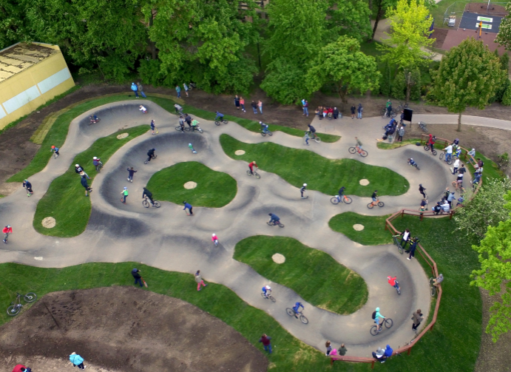
Pump Track
Skate Park History
Interest in Pump Tracks
Bringing one to Unalaska

Slide 4
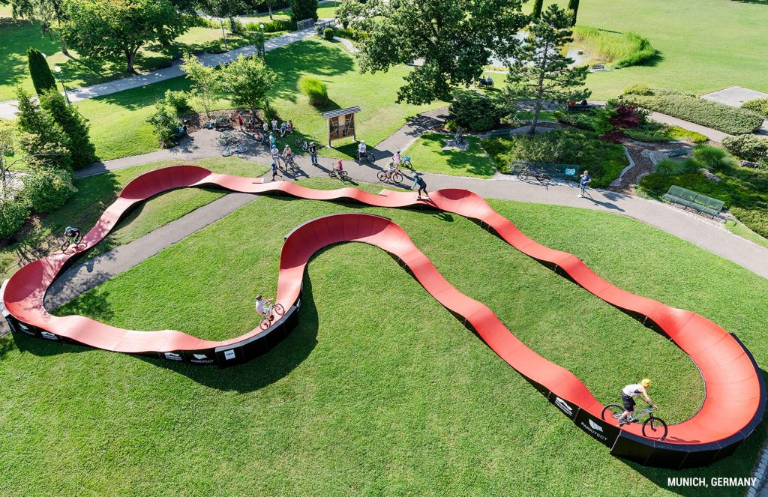
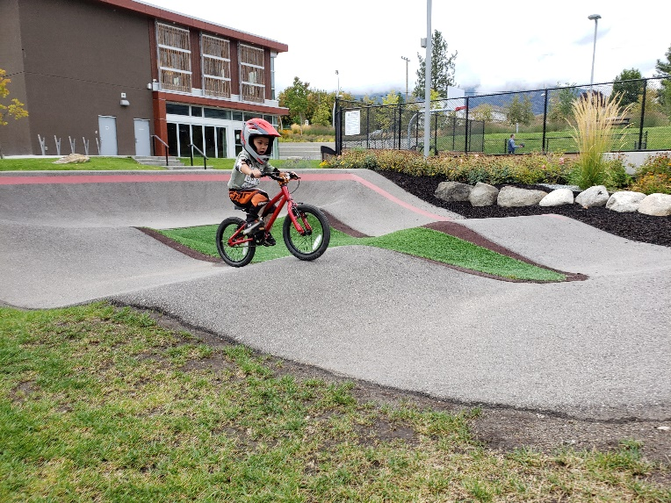
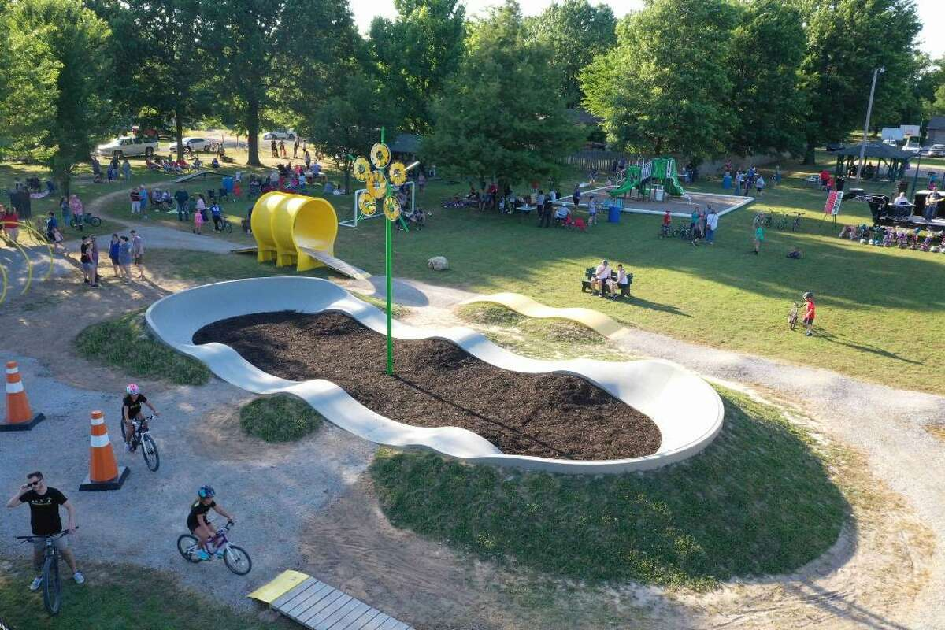
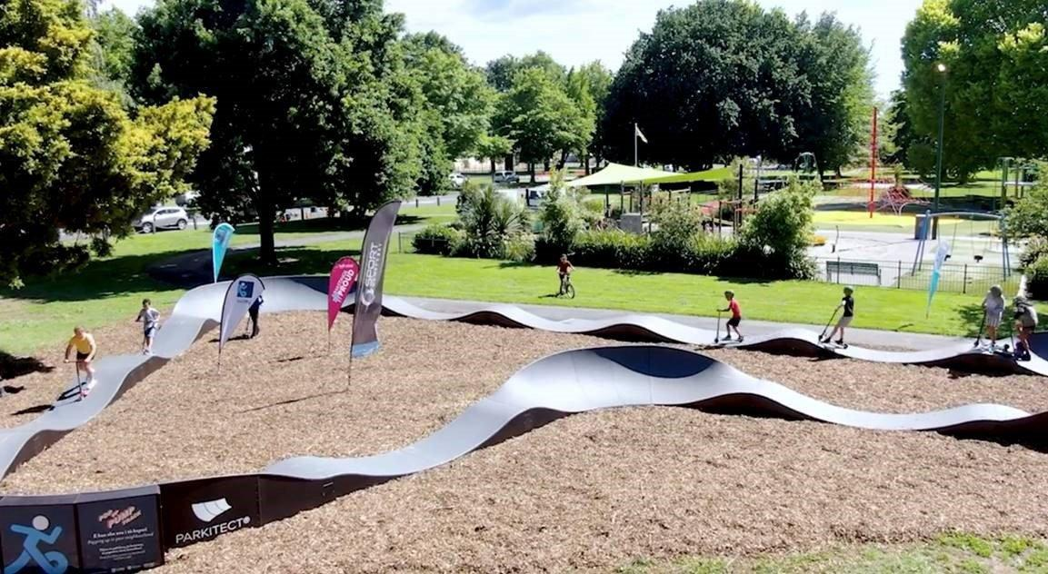
Pump tracks

Slide 5
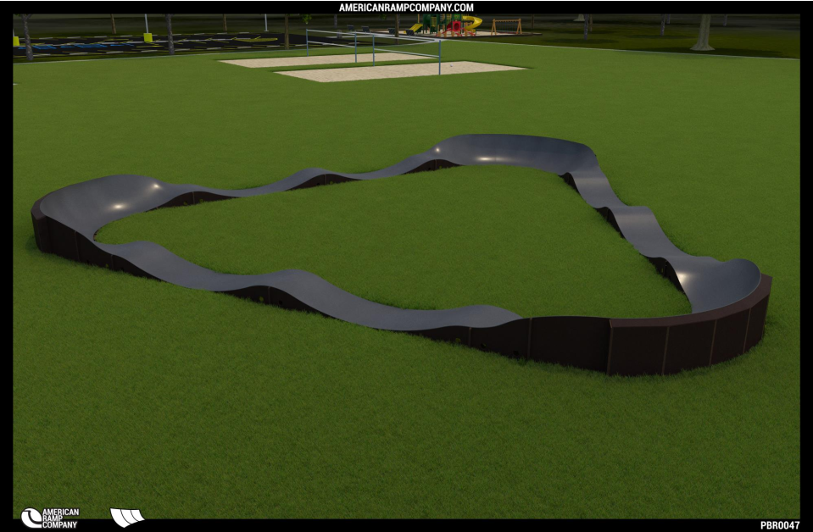
Pump Tracks

